Slide 1
Effect of Educational Attainment on per Capita Growth by State
Vicky, Adrianna, Jared, Liliya, Yousief

Slide 2
Selection of Topic
We have taken on the challenge to dissect the impact education has on per capita growth year over year on state level. The goal of our proposed question is to identify trends by state, region and/or education.
Collectively we hope to identify the indicators of monetary impact by educational attainment by state.

Slide 3


Data Source
Per Capita Income by State
Bureau of Economic Analysis: Regional Economic Accounts, Personal Income (State and Local), Annual Personal Income and Employment by State
https://apps.bea.gov/regional/downloadzip.cfm, SAINC5N_ALLAREAS_1998_2020.csv
Educational attainment
Census.gov: American Community Survey, Selected Social Characteristics in the United States,
https://data.census.gov/cedsci/table?q=DP02&g=0100000US%240400000&tid=ACSDP1Y2019.DP02

Slide 4
Questions to answer with the analysis:
The impact education has on per capita growth year over year in each state.
Will there be notable patterns?
Are there patterns between states?
Are there patterns between regions?
Are there outliers?
If so, which state or education attainment?

Slide 5
Data Exploration
Finding Key Features was the first step:
Education Levels:
- Less than 9th grade -9th to 12th grade - High School -Some College
-Associate’s Degree -Bachelor’s Degree - Graduate Degree
Dependent Variable/Target:
Per Capita Income

Slide 6
Data Exploration
Pulling all data to CSV file to determine which available features were going to be used in analysis
API pull of data from census.gov website for years 2005 - 2019
API pull varied between the years 2005 - 2007 to 2008 -2019 due to website and survey reconstruction
Download and preprocessing of per capita income by state from BEA website
Preprocessing in Jupyter Notebook:
Removing columns and rows deemed unnecessary in order to read data.
Converting objects to strings
Reordering columns
Plotting data to help determine the patterns to dive in deeper

Slide 7
Data Visualization - Tableau
https://public.tableau.com/app/profile/vicky.carlson/viz/EffectofEducationalAttainmentonPerCapitaIncomeGrowth/Story1

Slide 8
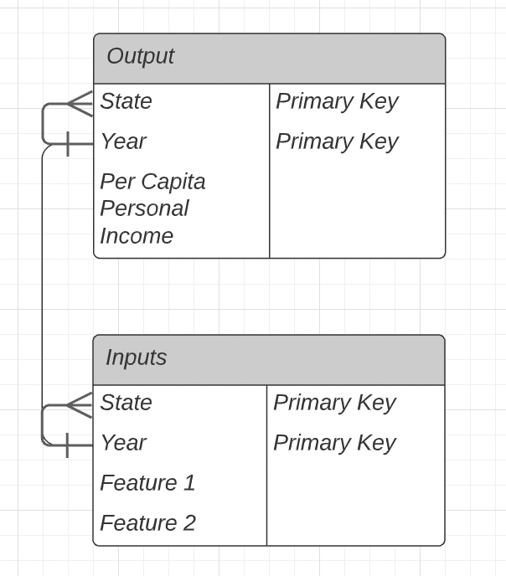
Databases
SQL pgAdmin
Database Creation
Database connected to Machine Learning Model
Data is then stored for future reference

Slide 9
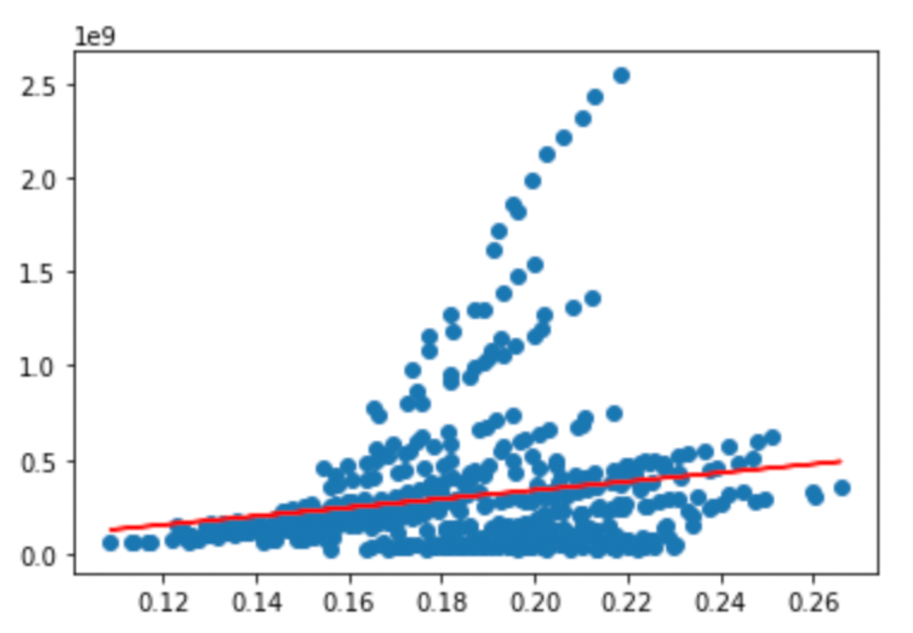
Analysis - Linear Regression
A positive linear regression relationship is observed with some outliers to identify further.
From the linear regression we were able to attain below metrics:
R2
Coefficients
Intercept

Slide 10
Analysis - Machine Learning
SKLearn Linear regression model
-

Slide 11
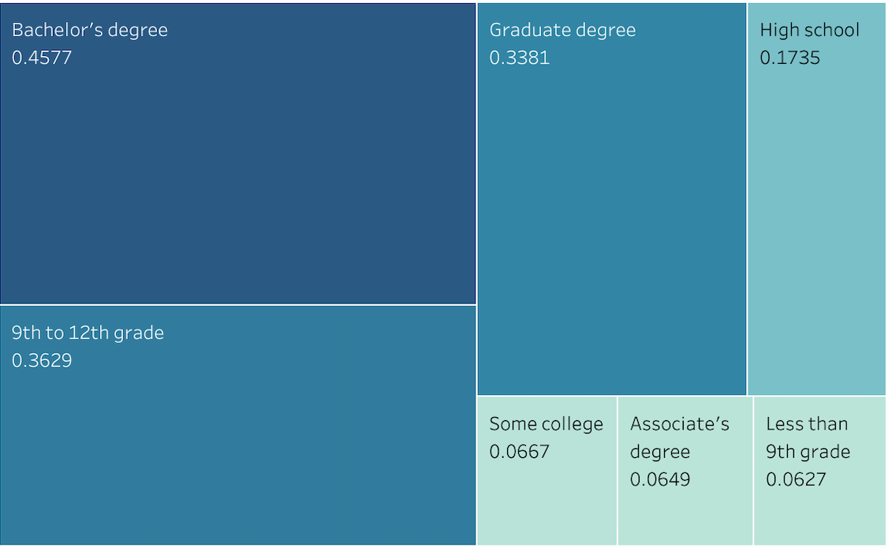
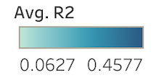
R Squared Indicator

Slide 12
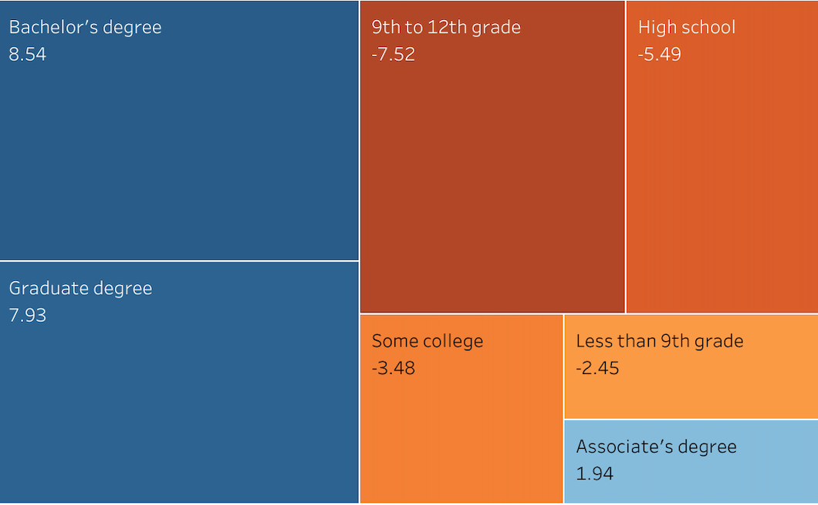
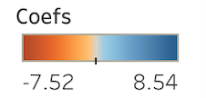
Coefficient Indicator

Slide 13
Result of analysis

Slide 14
Recommendation for future analysis

Slide 15
Anything that would be done differently

Slide 16
Technologies, Languages, Tools and Libraries
Python 3.7.11
Pandas 1.3.5
Requests 2.26.0
Census Data 1.15
Pathlib 2.3.6
Matplotlib 3.5.0
Sklearn 1.0
Jupyter 1.0
pgAdmin 5.7
PostgreSQL
Tableau Desktop 20.4.2
Tableau Public
Microsoft Excel
Google Drive, Docs, Slides

